Slide 1

Bell’s Theorem: The Venn Diagram Paradox
Nicolae-Andrei Vasile

Slide 2

Content
Bell’s Theorem: A Brief Introduction
Basic Concepts Regarding Bell’s Theorem
Experiments
Applications
Venn Diagram Paradox
Examples

Slide 3
Bell’s Theorem: A Brief Introduction
Brief Description
Basic Idea
a famous result in quantum mechanics that deals with the concept of entanglement.
first proposed by physicist John Bell in 1964 and has since been widely studied and tested through experiments.
certain correlations between particles in a quantum mechanical system cannot be explained by any local hidden variables.
if two particles are entangled, then the state of one particle cannot be fully described without reference to the state of the other particle, even if the two particles are separated by a large distance.
cannot be explained by classical physics.

Slide 4
any theory that assumes the existence of local hidden variables must obey certain inequalities, known as Bell's inequalities.
quantum mechanics predicts that these inequalities will be violated in certain situations, which has been confirmed by numerous experiments.
famous experiment that demonstrated the violation of Bell's inequalities is the Aspect experiment, which was conducted in 1982. In this experiment, entangled pairs of photons were generated and then measured at two distant locations. The results showed that the correlations between the photons were stronger than would be expected if there were local hidden variables.
significant for our understanding of the nature of reality. It suggests that the world is inherently non-local and that there are connections between particles that cannot be explained by classical physics.
has led to new areas of research in quantum mechanics, such as quantum teleportation and quantum cryptography.

Slide 5

Basic Concepts Regarding Bell’s Theorem
Three main concepts will be discussed further to ensure a basic understanding of the Bell’s Theorem:
Entanglement
Local Hidden Variables
Bell’s Inequality

Slide 6
Entanglement
strong correlation between two or more particles, such as atoms or photons.
if two particles are entangled, their quantum states become intertwined in such a way that the state of one particle cannot be described independently of the state of the other particle, even if they are separated by a large distance
seems to violate our classical understanding of cause and effect.
example:
if two entangled particles are separated by a large distance and the state of one particle is measured, the state of the other particle can be immediately determined, even if the two particles are light-years apart. This happens faster than the speed of light, which is the maximum speed at which any information can be transmitted according to the theory of relativity.

Slide 7
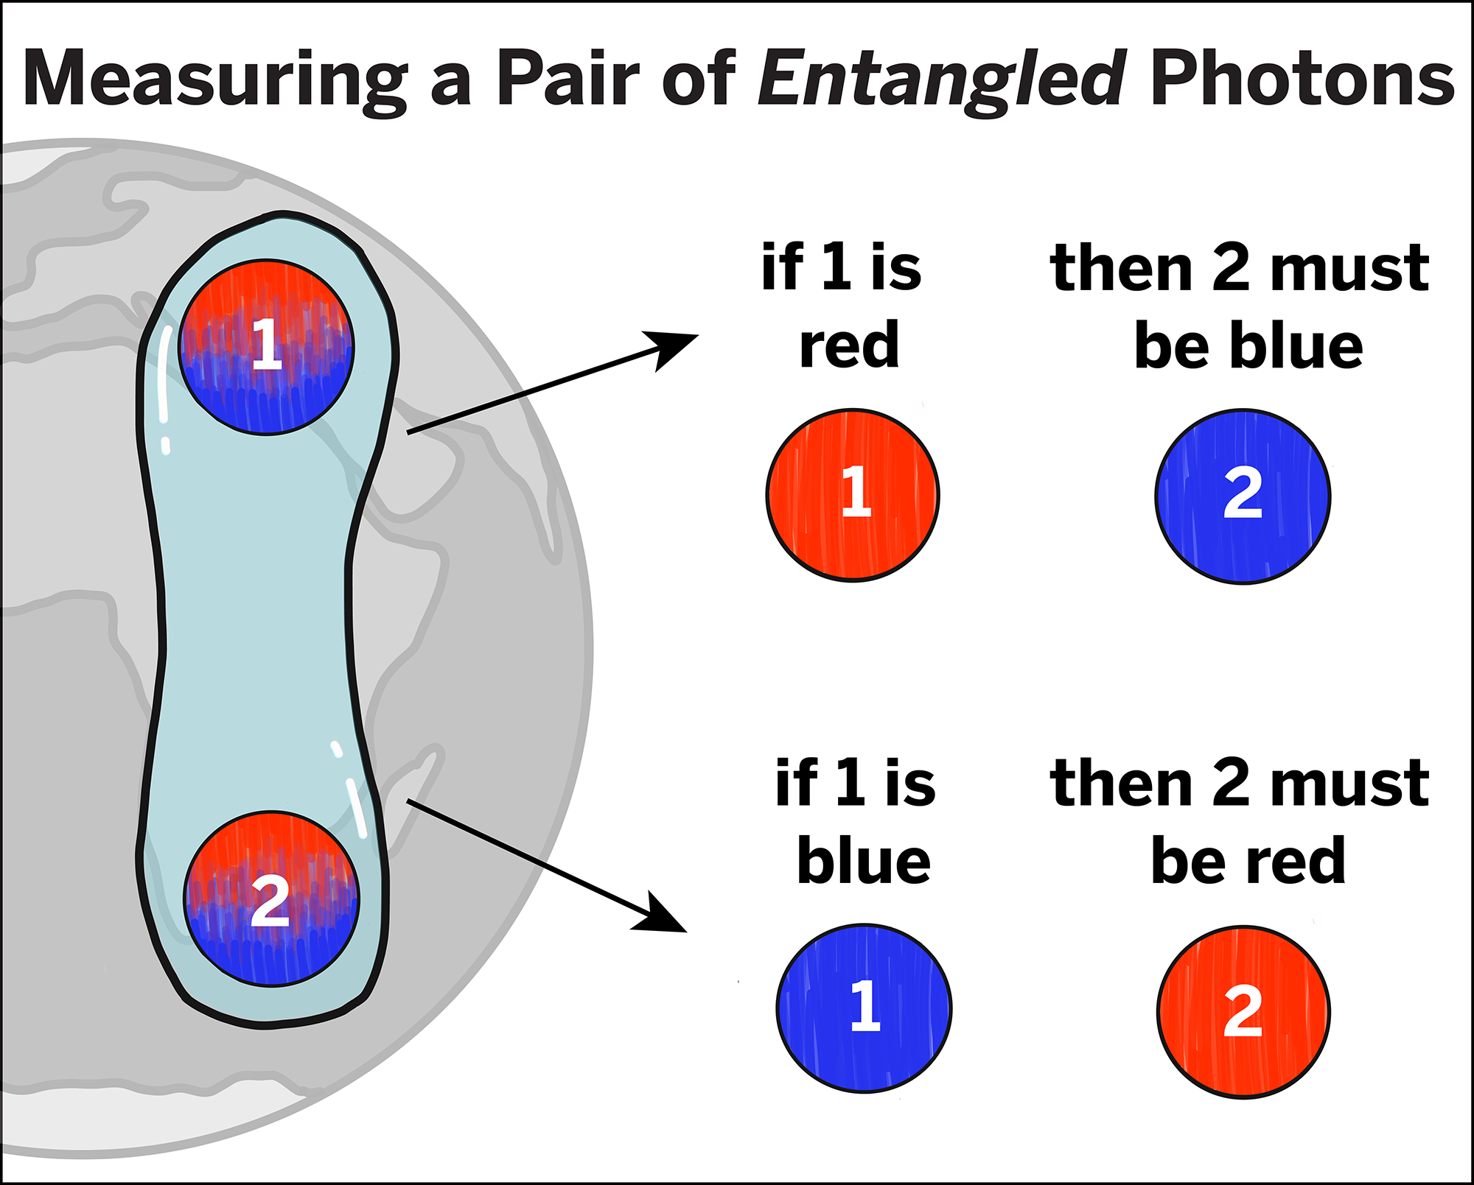

Slide 8
has been experimentally verified many times over the years, and it has been shown to be a fundamental feature of the quantum world.
one example of an experiment that demonstrates entanglement is the famous Einstein-Podolsky-Rosen (EPR) experiment:
two particles are created in such a way that they are entangled with each other. When the state of one particle is measured, the state of the other particle is immediately determined, even if the two particles are separated by a large distance.
a key ingredient in many quantum technologies, such as quantum computing and quantum cryptography.
a topic of ongoing research in the field of quantum mechanics.

Slide 9
Local Hidden Variables
refer to the idea that the behavior of quantum systems can be explained by some underlying physical parameters or variables that are hidden from observation.
the idea of local hidden variables is that these hidden variables determine the behavior of particles in a way that is consistent with classical mechanics, and that the apparent randomness of quantum measurements is simply a result of our lack of knowledge about these hidden variables.
idea was proposed by Einstein, Podolsky, and Rosen (EPR) in a famous paper in 1935, in which they argued that quantum mechanics was incomplete and that there must be some underlying physical theory that would explain the apparent randomness of quantum measurements.

Slide 10
in 1964, physicist John Bell showed that the predictions of quantum mechanics for certain experiments could not be explained by any local hidden variable theory.
this result is known as Bell's theorem, and it implies that there are inherent quantum correlations between particles that cannot be explained by classical physics.
is important in the study of the foundations of quantum mechanics, as it was one of the main objections to the theory in its early days.

Slide 11
Bell’s Inequality
a mathematical expression that is used to test whether a physical theory is consistent with local realism, which is the idea that the properties of particles in a system have definite values that exist independently of measurement and that these properties cannot be influenced by distant measurements or interactions.
first proposed by physicist John Bell in 1964 to test whether the predictions of quantum mechanics are consistent with local realism.
provides a way to distinguish between two types of correlations between the states of particles: those that can be explained by local realism and those that cannot.
one of the most famous Bell inequalities is known as the Clauser-Horne-Shimony-Holt (CHSH) inequality.

Slide 12
if a physical theory is consistent with local realism, then certain types of correlations between the states of particles should satisfy a specific mathematical relationship, known as a Bell inequality.
experiments in quantum mechanics have shown that the correlations between entangled particles violate Bell's inequality, indicating that these correlations cannot be explained by local realism and that the properties of particles in a system cannot have definite values until they are measured.
the violation of Bell's inequality is taken as evidence that the world is not governed by local realism, and that the properties of particles are inherently quantum mechanical in nature, with their values not determined until they are measured.

Slide 13

Experiments
two experiments regarding Bell’s theorem will be presented further:
the EPR (Einstein-Podolsky-Rosen) experiment
the “Quantum Teleportation” experiment

Slide 14
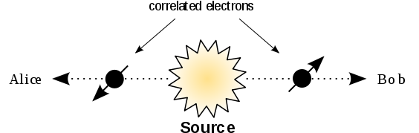
EPR (Einstein-Podolsky-Rosen) Experiment
famous thought experiment in quantum mechanics that was first proposed in 1935 by Albert Einstein, Boris Podolsky, and Nathan Rosen.
designed to illustrate what the authors saw as a fundamental problem with the then-emerging theory of quantum mechanics, which they believed was incomplete.

Slide 15
EPR experiment involves two particles that are entangled with each other. When two particles are entangled, their quantum states become correlated in a way that cannot be explained by classical physics. This means that if the state of one particle is measured, the state of the other particle can be immediately determined, even if the two particles are separated by a large distance.
the two particles are allowed to fly apart from each other and travel to two different locations, which are far enough apart that they cannot communicate with each other by any classical means. At each location, the experimenter measures the spin of the particle along a particular axis.
according to the laws of quantum mechanics, the measurement of one particle's spin will immediately determine the spin of the other particle, even though the two particles are far apart.
this violates the principle of locality, which states that any influence must travel at or below the speed of light.

Slide 16
“Quantum Teleportation” Experiment
a technique used in quantum communication and quantum computing that allows for the transfer of quantum information from one location to another, without physically transporting the quantum state itself.
two entangled qubits are used to transmit information from one location to another. The qubits are in a special state known as a Bell state, which is a superposition of two states with opposite spin. One of the qubits is kept at the "sender" location, and the other is sent to the "receiver" location.
the sender also needs a third qubit that has an unknown quantum state that they want to transmit to the receiver. The sender performs a special operation called a Bell measurement on their two qubits, which "collapses" the entangled state of the receiver's qubit. They then obtain two classical bits of information from the measurement result and send them to the receiver using classical communication.

Slide 17
receiver then uses the classical bits to perform a specific operation on their qubit, which "reconstructs" the unknown quantum state that was originally held by the sender's third qubit.
this method of teleportation does not allow for faster-than-light communication, as the classical communication between the sender and receiver is still required to transmit the two classical bits of information.

Slide 18
Applications of Bell’s Theorem
Quantum Cryptography
one practical example of an implementation of Bell's theorem is in the field of device-independent quantum cryptography, which is a type of quantum communication that does not rely on assumptions about the physical properties of the underlying quantum devices.
the basic idea behind device-independent quantum cryptography is to prepare a pair of entangled particles, such as photons, and send one particle to each of two distant parties, Alice and Bob, who wish to communicate securely. Alice and Bob each perform measurements on their respective particles and compare the results to a pre-determined set of measurement settings.

Slide 19
Testing of Quantum Mechanics Against Local Hidden Variable Theories
another practical example of an implementation of Bell's theorem is in the testing of quantum mechanics against local hidden variable theories.
experimental tests of Bell's inequality have been conducted to test the predictions of quantum mechanics against the predictions of local hidden variable theories.
in these experiments, entangled particle pairs are prepared, and measurements are made on each particle in a way that violates Bell's inequality. If the measurements violate Bell's inequality, then the predictions of quantum mechanics are confirmed, and local hidden variable theories are ruled out as a possible explanation for the observed correlations.
famous example of such an experiment is the Aspect experiment.

Slide 20
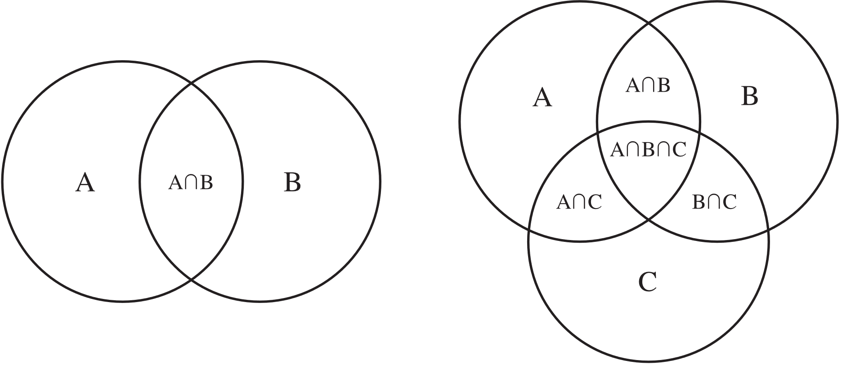
The Venn Diagram Paradox
a Venn diagram is a graphical representation of sets, used to visually show the relationships between different sets and their elements.
commonly used in mathematics, statistics, and other fields to illustrate concepts related to set theory, logic, and probability.
paradox arises when a Venn diagram is used to represent a logical statement that is not valid, leading to a contradiction.

Slide 21
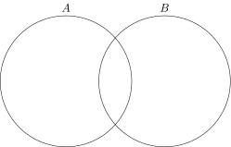
Example:
consider a Venn diagram with two overlapping circles: one circle represents the set of all things that are red, and the other circle represents the set of all things that are not green.
the statement "all red things are not green“ would be represented by shading the entire region inside the red circle, while leaving the entire region inside the green circle unshaded.
the statement "no green things are red," on the other hand, would be represented by shading the entire region inside the green circle, while leaving the entire region inside the red circle unshaded.
creates the appearance of a paradox, because the two statements appear to describe different sets, even though they are logically equivalent.

Slide 22
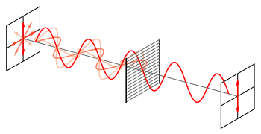
Polarization
photons are waves in an electromagnetic field, and polarization just means the direction in which that wave oscillates.
polarizing filters absorb this energy in one direction, so the wave coming out the other side is oscillating purely in the direction perpendicular to the one where energy absorption is happening.
photons – quantum objects (they either pass through, or not).

Slide 23
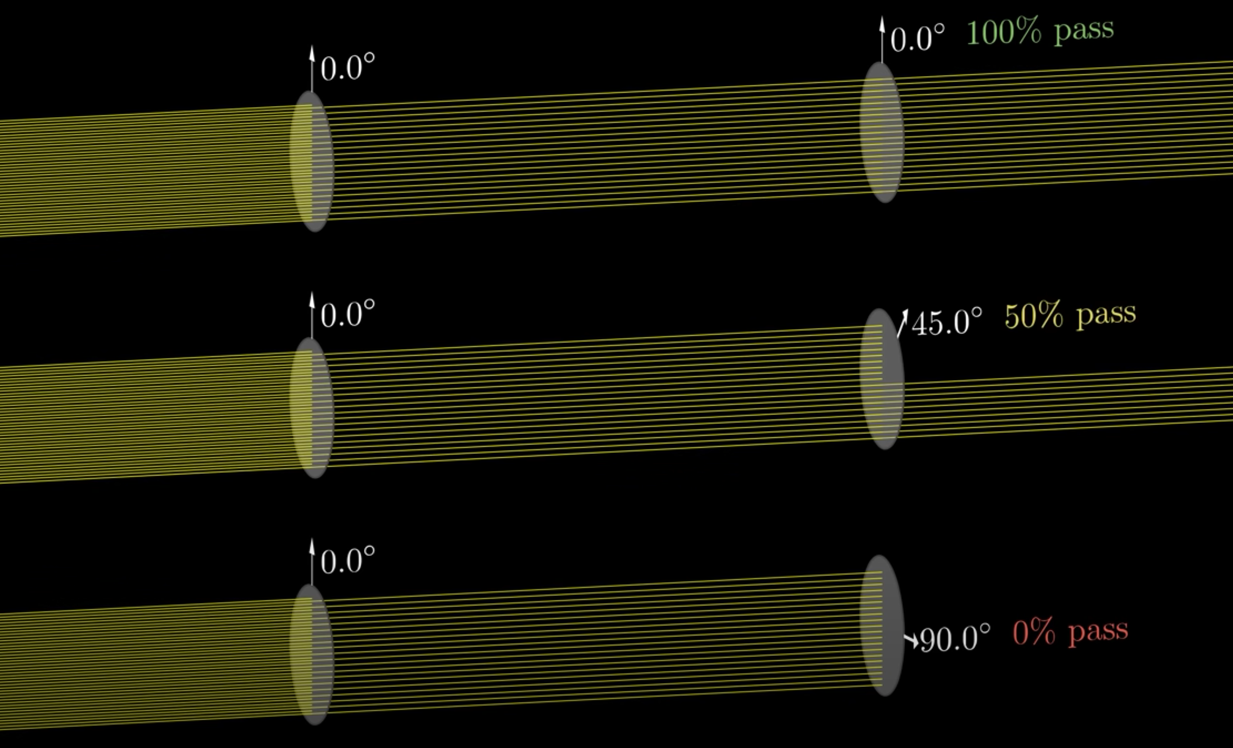
when the filter is placed at 0 degrees, there is a 100% chance of passing.
when the filter is placed at 45 degrees, there is a 50% chance of passing.
when the filter is placed at 90 degrees, there is a 0% chance of passing.

Slide 24
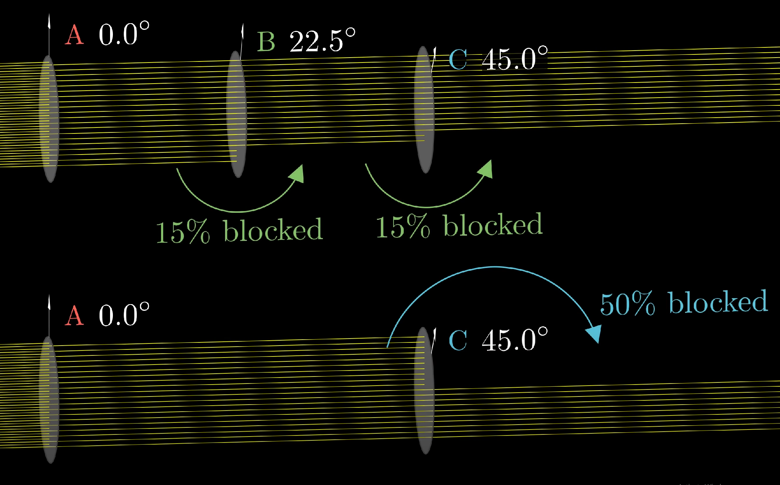
Experiment:
two cases are going to be studied:
how light will go through 3 filters at 0, 22.5 and 45 degrees, respectively.
how light will go through 2 filters at 0 and 45 degrees, respectively.
in the first case, 15% of the photons that pass filter A, get blocked by filter B and 15% that pass filter B as well, get blocked at filter C. This means that 30% of the photons get blocked between filter A and C, a result much lower than expected.
in the second case, 50% of the photons that pass filter A get blocked by filter B.

Slide 25
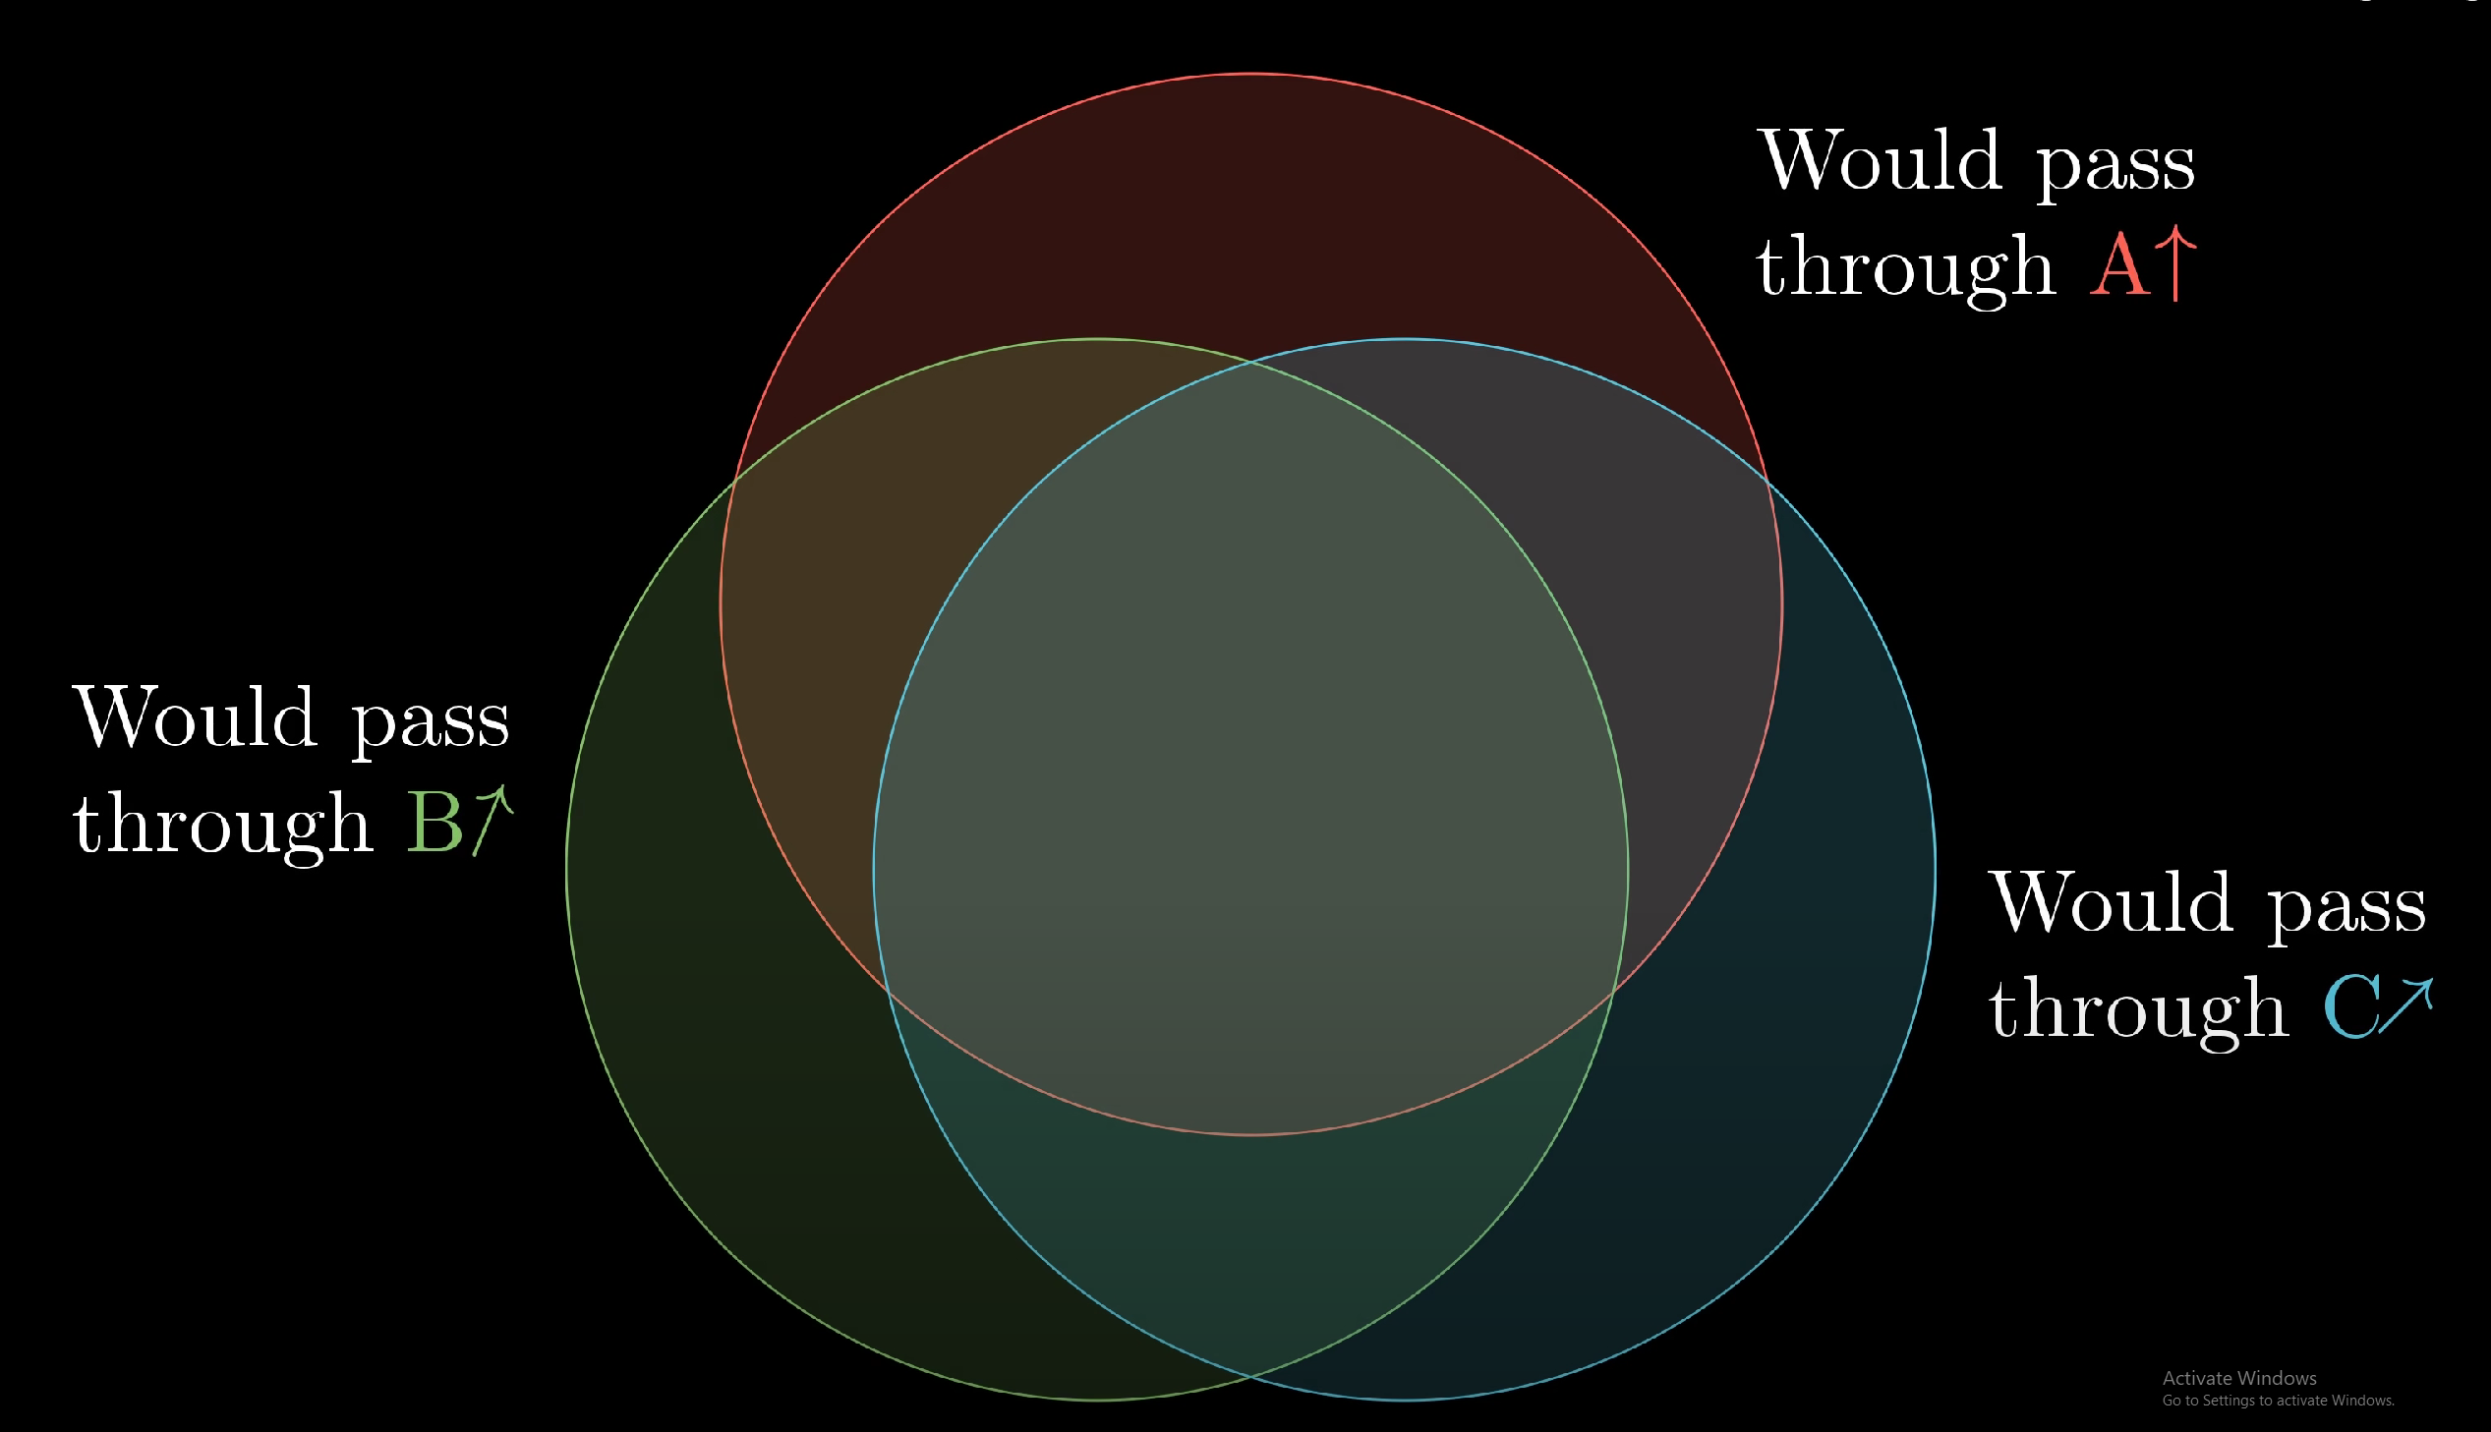
If filter B is added:
15% of the photons that pass filter A get blocked by filter B.
15% of the photons that pass filter B get blocked by filter C.
If filter B is removed:
50% of the photons that pass filter A get blocked by filter B.
This violates the Venn diagram understanding of the static mathematical structure.

Slide 26
Entangled Polarization
Let there be pairs of entangled photons that instead of going through multiple sequential filters, each of them will attempt to pass filters and that are far away of one another.
The experiment shows that the exact same values are obtained as if thy would pass through sequential filters.
If there would be sets of filters with different combinations of angles (described previously) and far away from one another, we would have the following statistics:
0% of the entangled photons that pass filter A get blocked by filter B.
15% of the entangled photons that pass filter A get blocked by filter B.
15% of the entangled photons that pass filter B get blocked by filter C.
50% of the entangled photons that pass filter A get blocked by filter C.

Slide 27
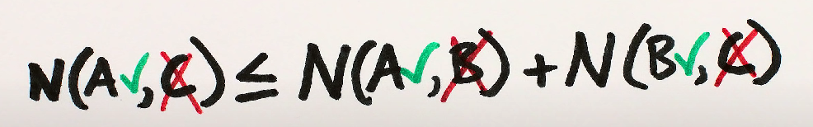
Correlation with Bell’s Inequality
those results violate a simple mathematical understanding of how polarizing filters work:
N(X, Y) is the number of the photons that pass filter X and get blocked by Y.
this is a simple example of what it is called a Bell’s inequality, stating that the physics of the photons that pass through the filters cannot be explained by local realism laws.

Slide 28
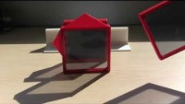
Example

Slide 29

Thank you!

